Slide 1
Data 101 – HW2
Ryan Lee

Slide 2
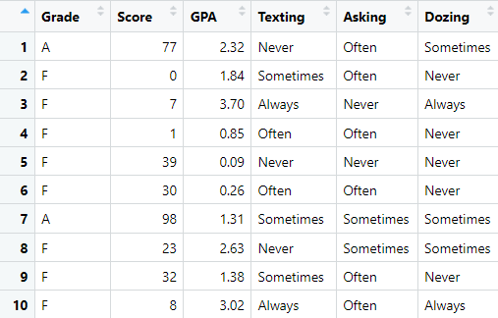
Overview
Number of Students : 2000
Number of Attributes: 6
Categorical : Grade, Texting, Asking, Dozing
Numerical : Score, GPA
Number of values per categorical Attributes
Grade: 4 (A,B,C,F)
Texting: 4 (Always, Never, Often, Sometimes)
Asking: 3(Never, Often, Sometimes)
Dozing: 3(Always, Never, Sometimes)

Slide 3
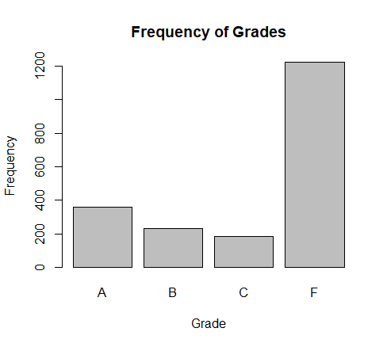
Distribution of Grades
F has the biggest portion in the class. (We can assume class is tough)
Then A is second, B is third, and C has the least number of students
It is not useful

Slide 4
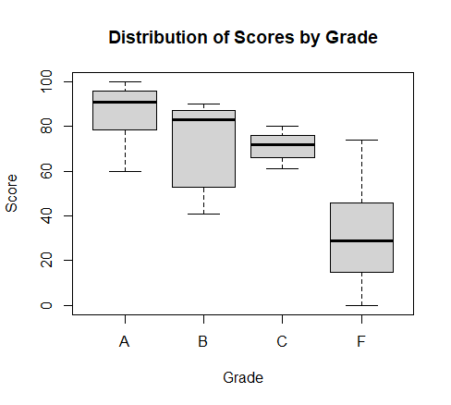
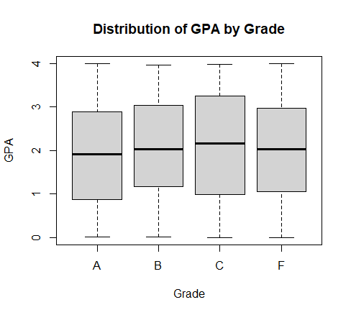
Distribution of Scores and GPA by Grade
Scores are overlapping. If you get 70, you can get any grade between A,B,C,F.
Prof is not assigning grades based on scores.
GPA does not have much correlation with the Grade.

Slide 5
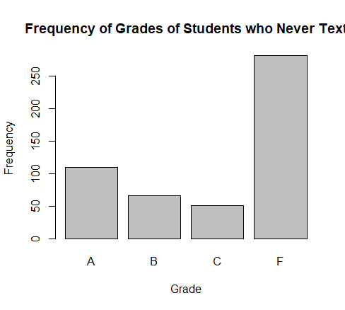
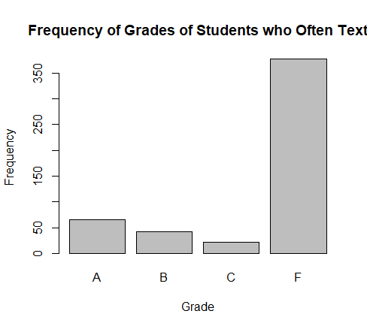
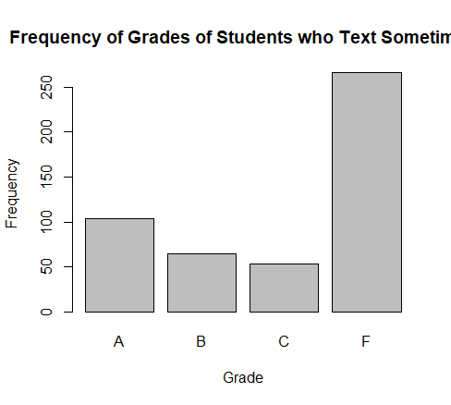
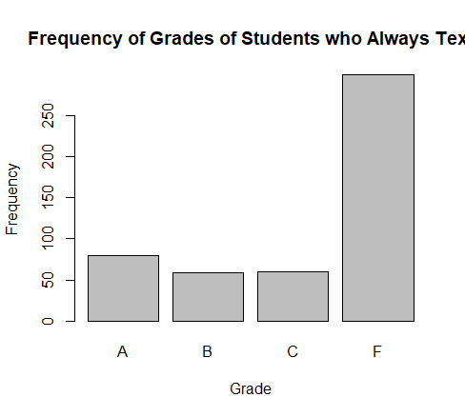
Splitting up by Texting Attribute
Students who text always or often have more likely to have lower grades than other groups. (C&F)
Students who text never or sometimes have more likely to have higher grades than other groups. (A&B)

Slide 6
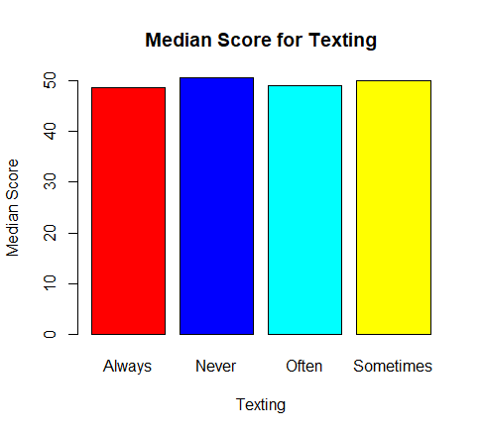
Splitting up by Texting Attribute
Students who never text have higher average score.

Slide 7
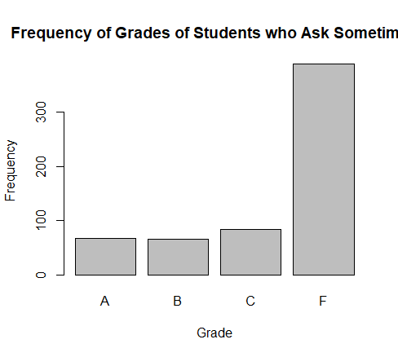
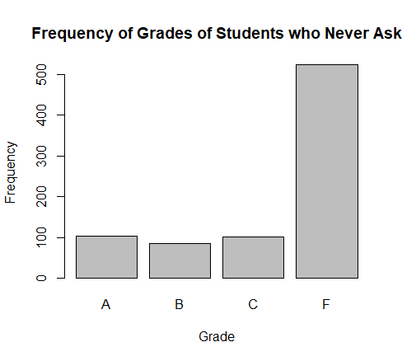
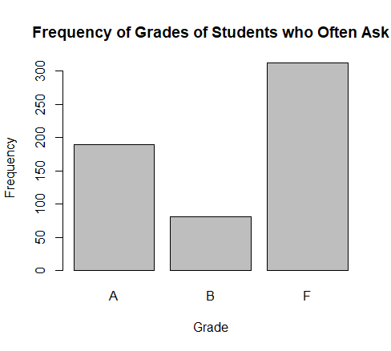
Splitting up by Asking Attribute
Students who often ask have more A’s than other groups.
Students who never ask have more F’s than other groups.

Slide 8
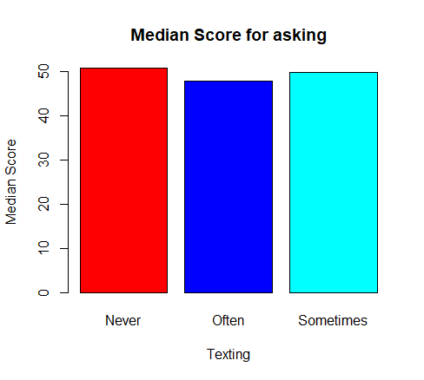
Splitting up by Asking Attribute
Students who never ask have highest average score.
Students who often ask have lowest average score.

Slide 9
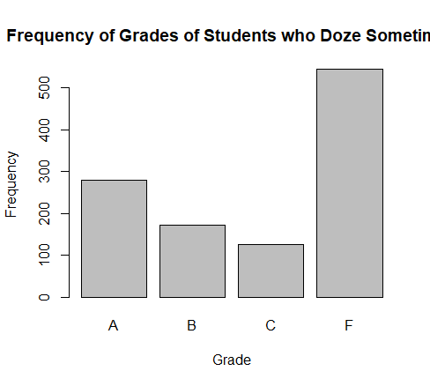

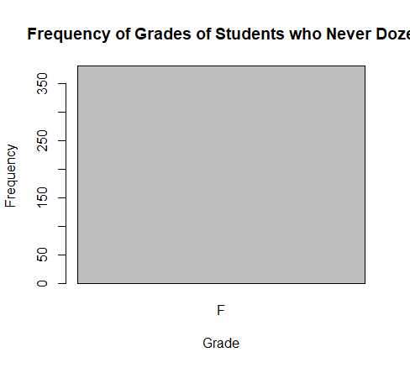
Splitting up by Dozing Attribute
Students who doze sometimes have more A’s than students who always or never doze.
All students who never doze get F.

Slide 10

Splitting up by Dozing Attribute
Students who never doze have highest score.
Students often doze have lowest score.

Slide 11
Conclusion
Certain patterns can be recognized through this analyze.
Over 60% of students get F, so Moody’s class is tough to pass.
Not texting or texting as little as possible is advantageous for getting a higher grade (page 5).
Question often is advantageous for getting a higher grade (page 7).
Dozing does not affect a lot for the grade since all students who never doze got F. However, try not to doze as much as possible since students who sometimes doze have more likely to have higher grade than students who often doze (page 9).

